Slide 1
Raspberry Pi
VPN Project
CIT 490
By: Michael Short

Slide 2
Introduction
Basic VPN Concept
Phase I: Operating System Research and Configuration
Phase II: Research and Selection of VPN Server Software
Phase III: Create a Web Based System Configuration Tool on Device
Phase IV: Source / Deliverable / Docs / Video Presentation

Slide 3
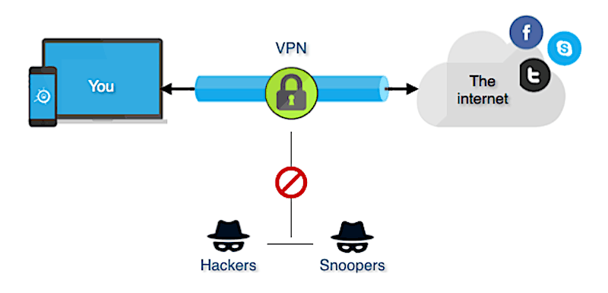
Basic VPN Concepts
Communications are Secured by using Encryption to Scramble Data
Connects a Device to another Network as if it were Physically on that Network
Partial or All Traffic can be sent through the VPN
Benefits:
Increase Privacy
Access Secured Networks from Unsecured Internet Connections
Appear to be in Another Geographic Location

Slide 4

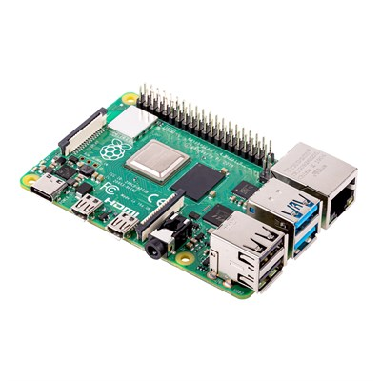

Phase I (Weeks 1 & 2)
Operating System Research and Configuration
Hardware:
Raspberry Pi 4
USB 3.0 Gigabit Ethernet Adapter
Software:
Slackware Linux for ARM v15.0

Slide 5
Phase I (Weeks 1 & 2) [Cont.]
Operating System Research and Configuration
Hardware Choice:
Compact Size
Good Speed / Features
USB 3.0
8GB RAM
Software Selection:
Command Line Based OS
Personal Interest for Embedded Systems and Linux Operating System
Lightweight
Already Familiar with Slackware Linux for i386/x86_64 Hardware
Operating System Preparation

Slide 6

Phase II (Weeks 3,4,5 & 6)
Research and Select VPN Server Software
VPN Software Chosen:
Clients Available for Windows, OSX, Linux
Communicates over UDP
Uses Public/Private Key Encryption
Only Communicates when it Needs too (Not overly Chatty)
Configuration / Concepts are Easy to Understand
Low Resource Usage

Slide 7
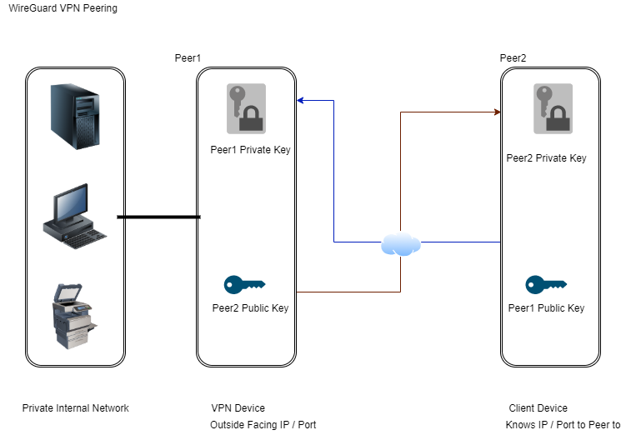
Simple Peering Diagram

Slide 8
Phase III (Weeks 7,8,9,10, & 11)
Create Web Based System Configuration Tool on Device
Live
Demonstration

Slide 9
Phase IV (Weeks 12 & 13)
Source / Deliverable / Docs / Video Presentation
GIT Repository with C Source Code / Scripts / Web Content
https://github.com/short-michael/WGVPN.git
Bootable Image (Deliverable)
https://alcatraz.fawkesengineering.com/mike/privado/WGVPN.img.xz
Documentation on Device Configuration
See docs directory in the above mentioned GIT repository
Video Presentation / Demonstration

Slide 10
Resources
Sources for Images used in this Presentation:
https://www.canakit.com/Media/400/1467.jpg
https://images-na.ssl-images-amazon.com/images/I/41C1eanEKuL._SY90_.jpg
http://arm.slackware.com/images/slackware.png
https://networkencyclopedia.com/wp-content/uploads/2019/09/vpn-diagram.png
https://www.wireguard.com/img/icons/og-logo.png?a=obiDa7ee
Peering Diagram Created Using Draw.io:
https://app.diagrams.net/

